Slide 1
Predicting House Prices
Jalnar Ali Alshehri
446813465
4

Slide 2

The objectives
Develop a model that accurately estimates the price of a house based on various features, such as its size, number of bedrooms and bathrooms, location (latitude and longitude), condition. The model should minimize prediction error, capturing complex relationships between features while accounting for both linear and non-linear patterns in the data. By understanding how features like location, square footage, influence price, the model can generalize well to new data and handle outliers effectively. The goal is to provide reliable price predictions for new listings, helping stakeholders understand the relative importance of different features and make informed decisions about house prices in different contexts.
Data Source
House sales in King County, USA. (2016, August 25). Kaggle. https://www.kaggle.com/datasets/harlfoxem/housesalesprediction
09/12/2024
11

Slide 3
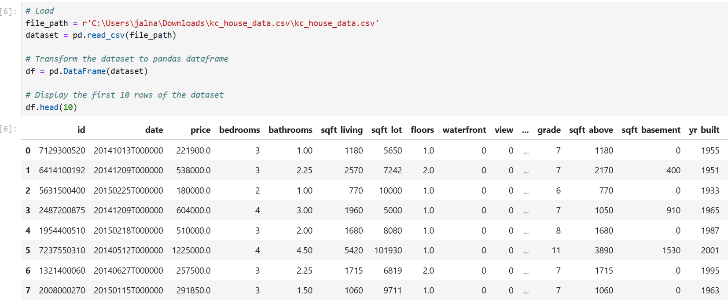
Load The Dataset
12/9/2024
5

Slide 4
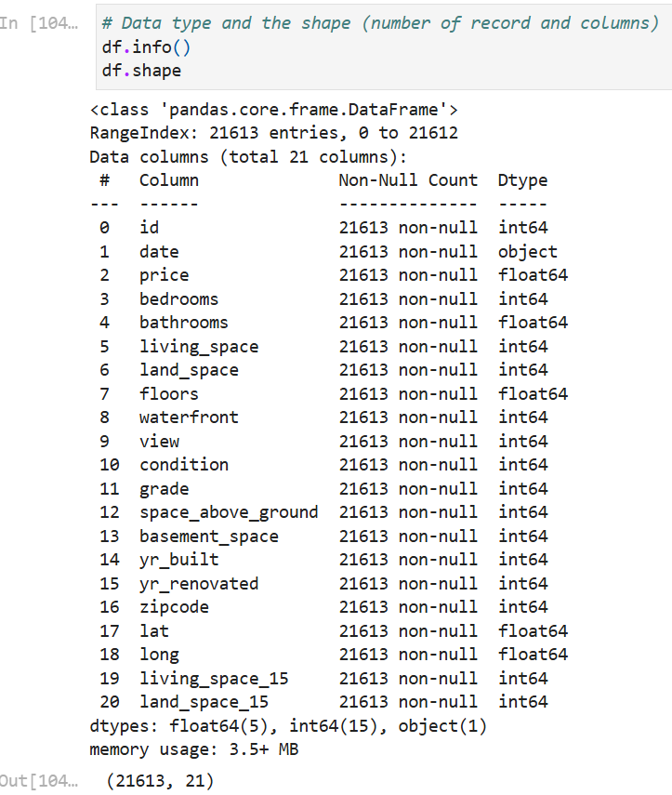
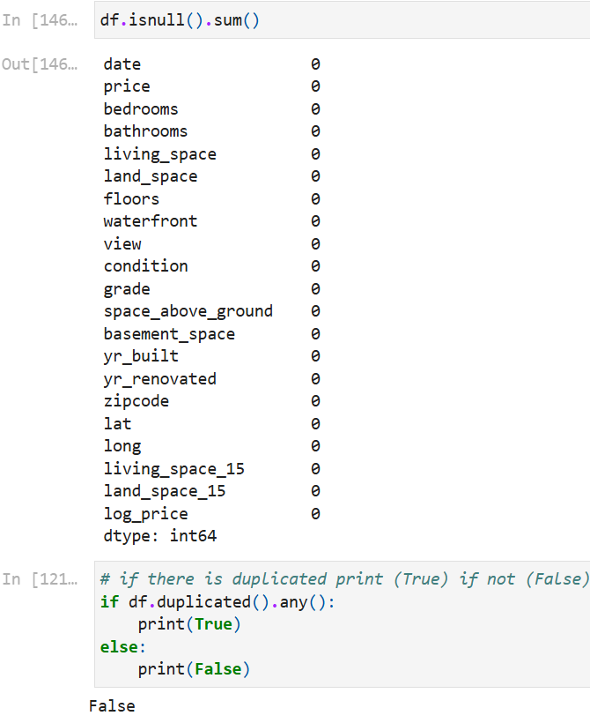
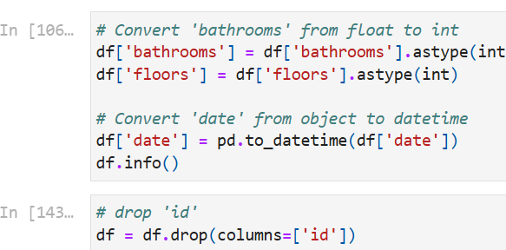
EDA
12/9/2024
3

Slide 5
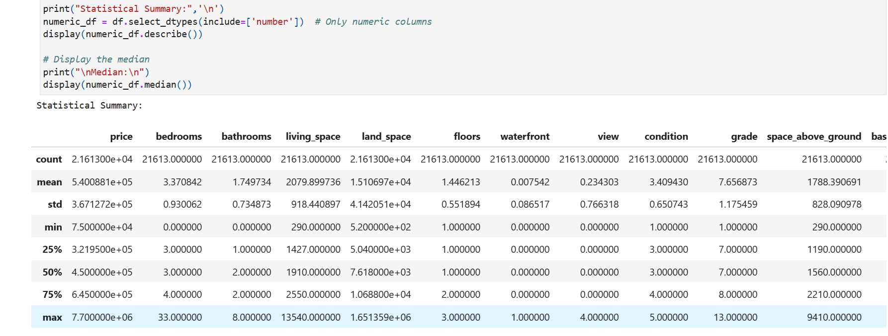
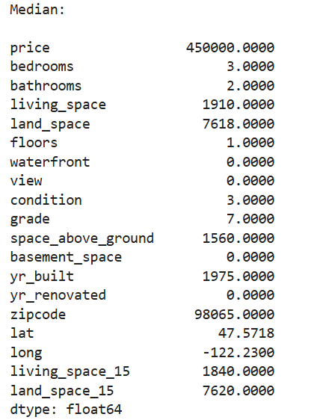
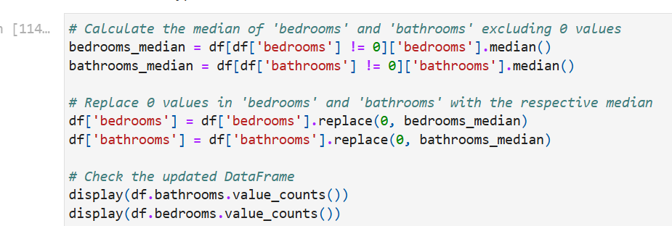
Descriptive Statistics
12/9/2024
2

Slide 6
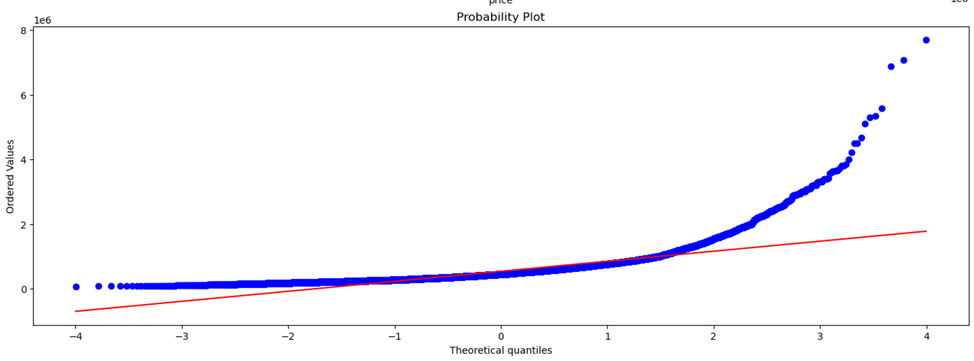
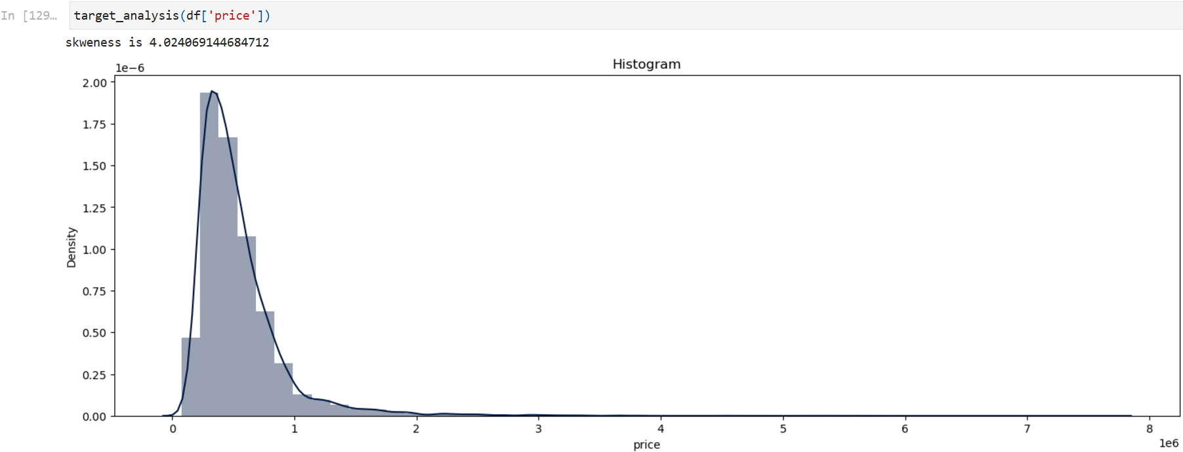
Distribution Of The Dependent Feature (target)
12/9/2024
2

Slide 7
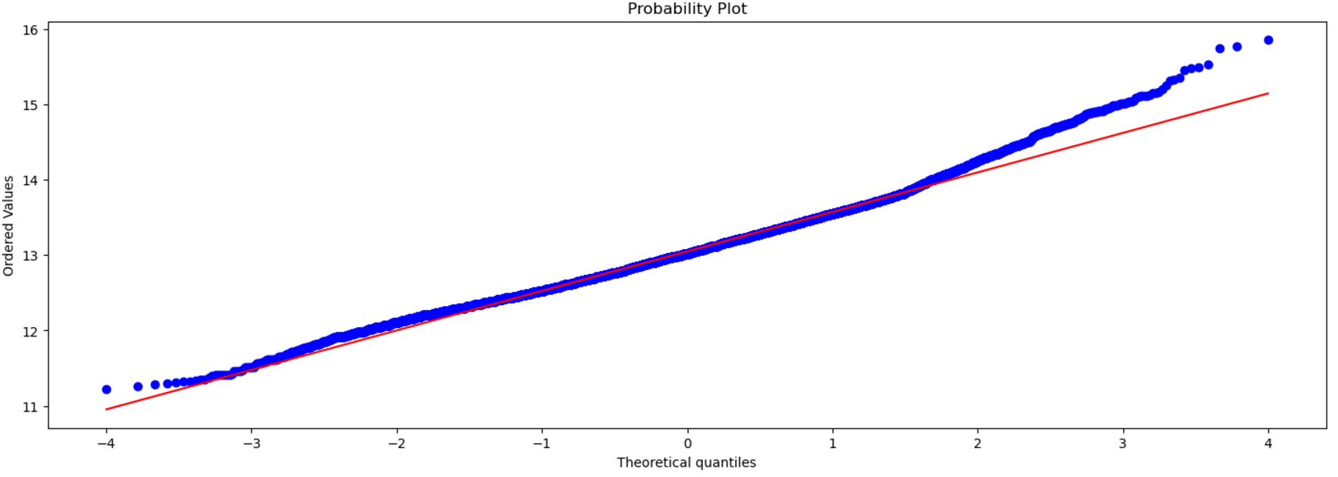
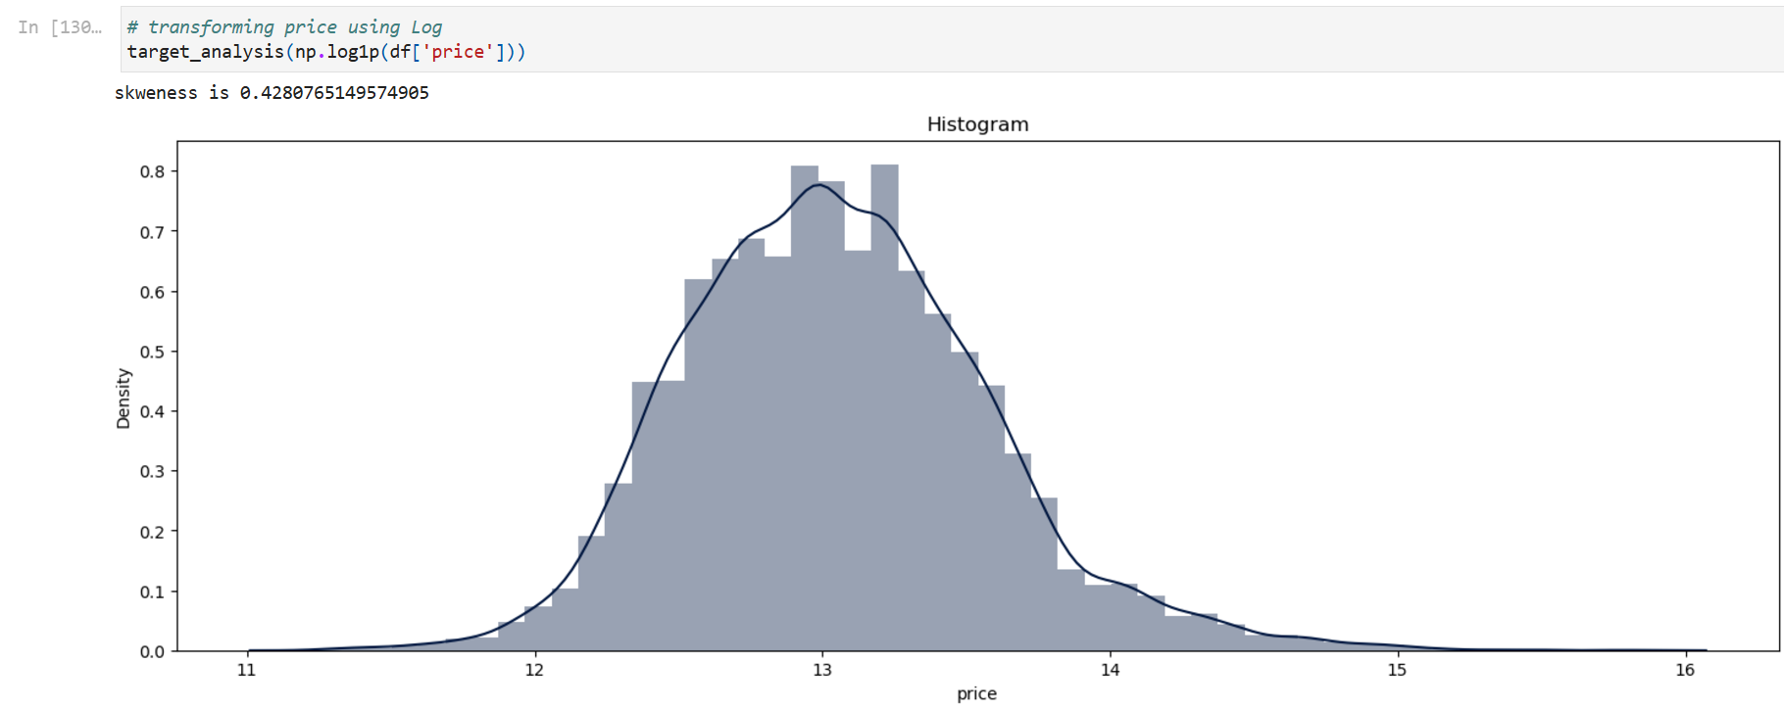
Distribution Of The Dependent Feature (target)
12/9/2024
6

Slide 8
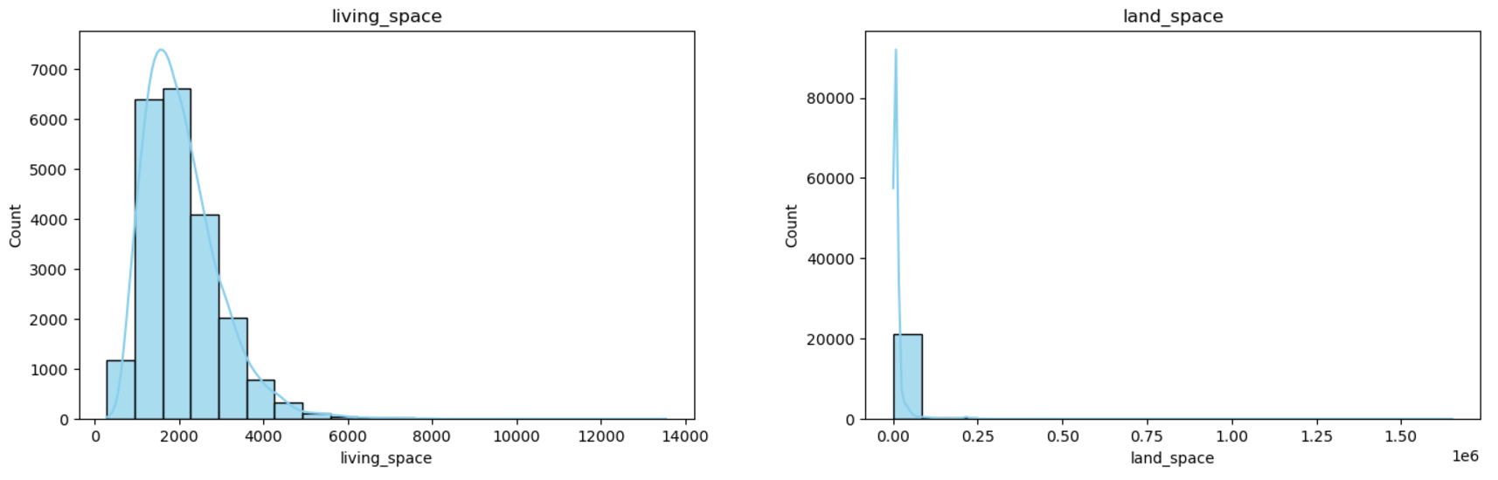
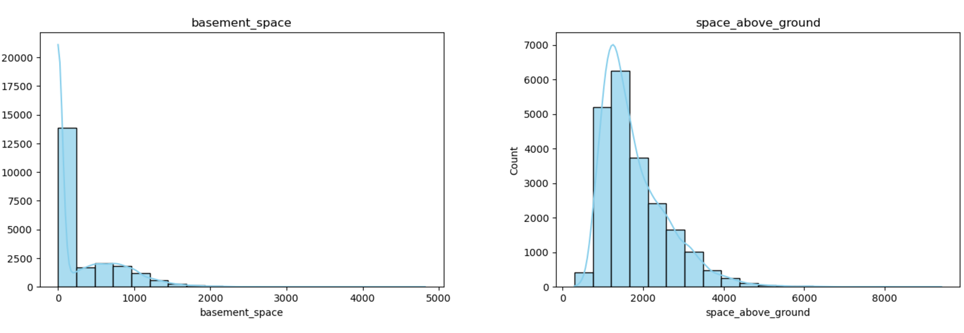
Distribution Of The Independent Features
12/9/2024
7

Slide 9
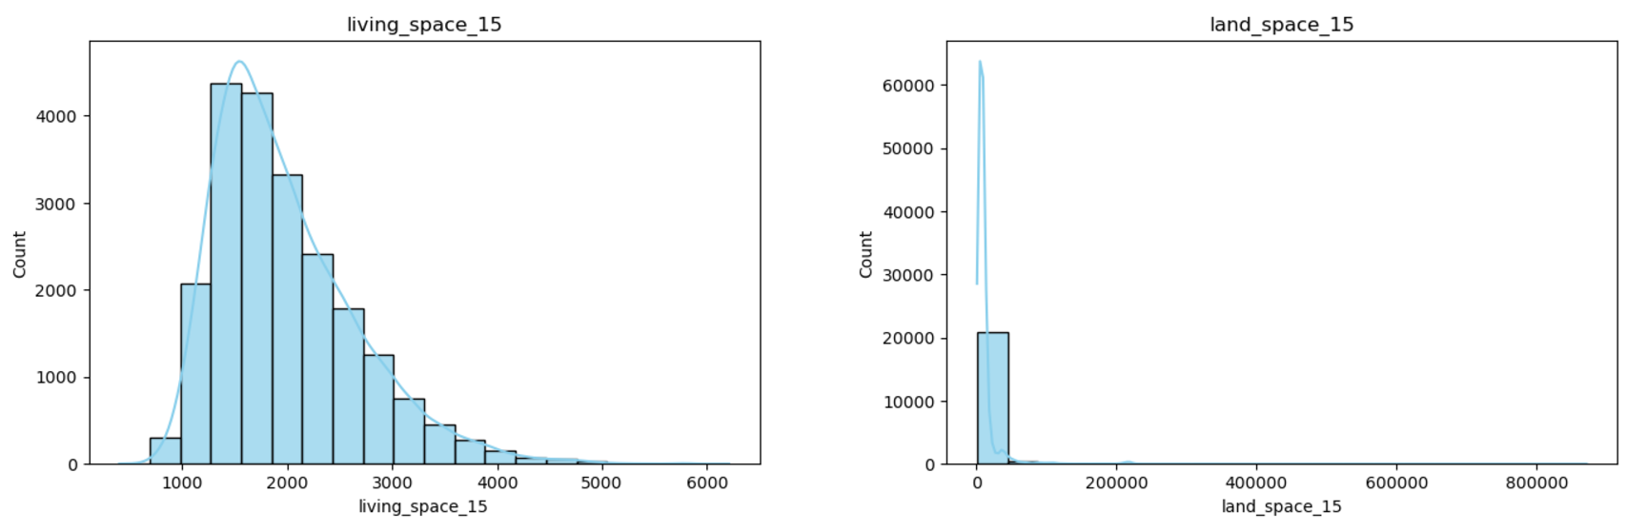
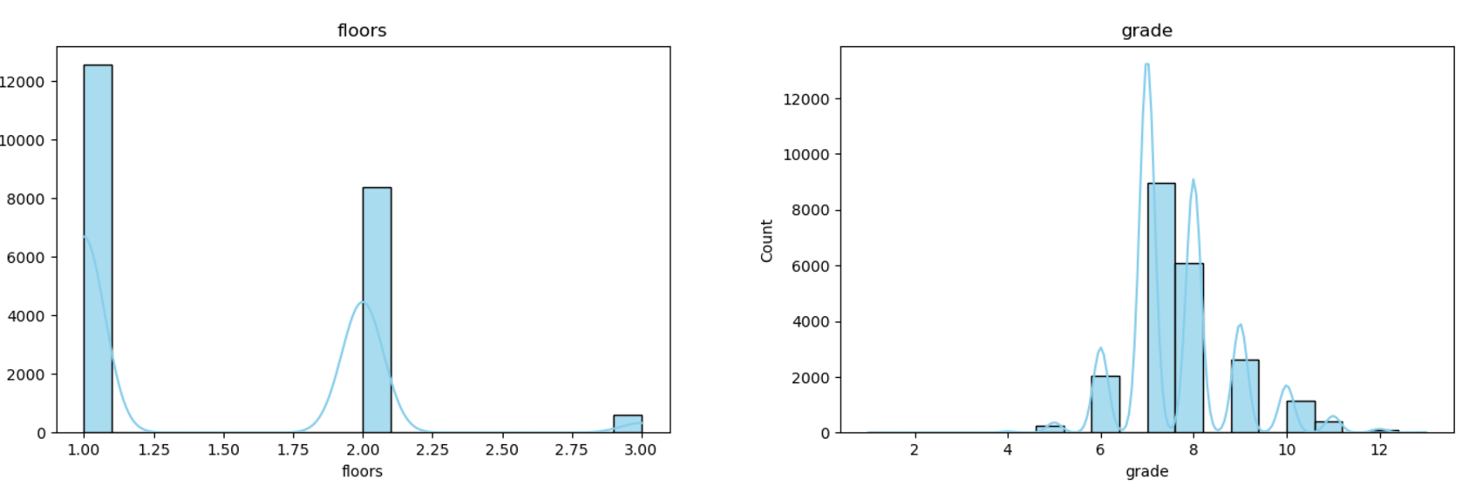
Distribution Of The Independent Features
12/9/2024
8

Slide 10
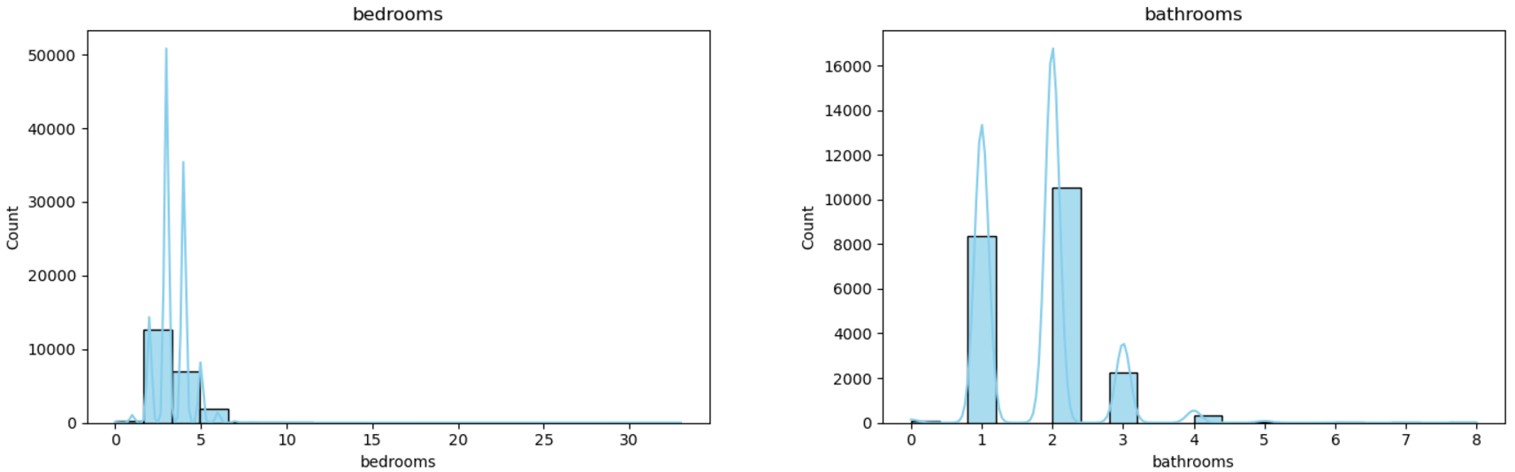
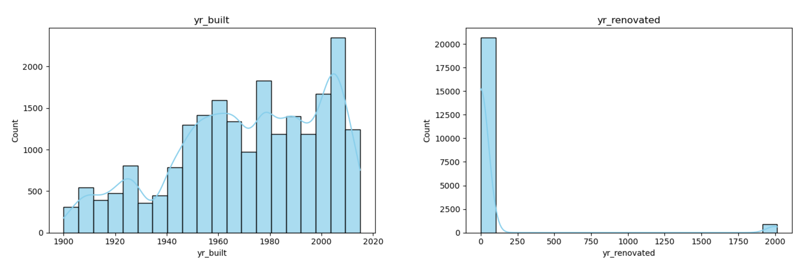
Distribution Of The Independent Features
12/9/2024
9

Slide 11
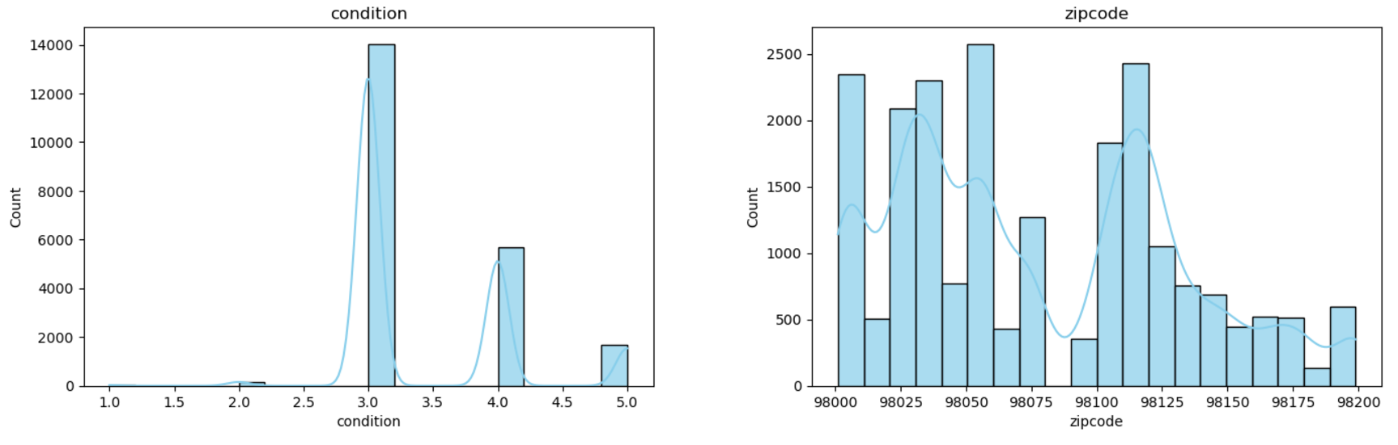
Distribution Of The Independent Features
09/12/2024
2

Slide 12
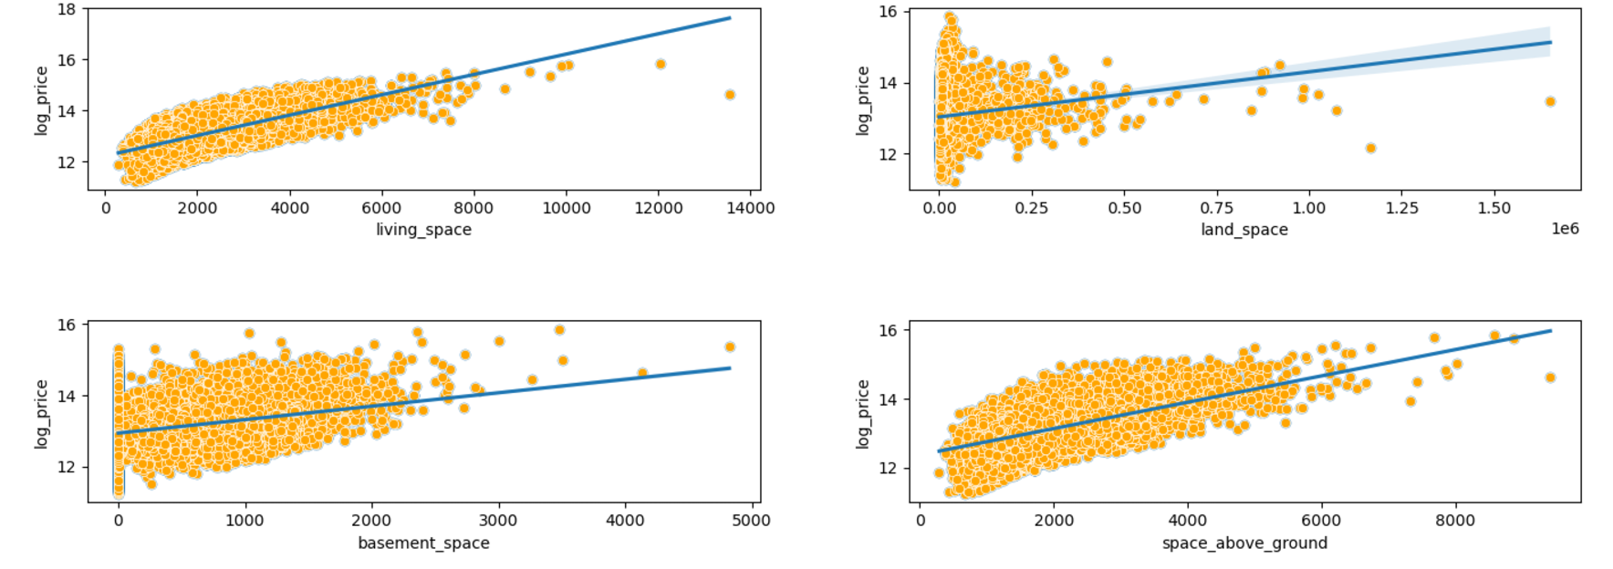
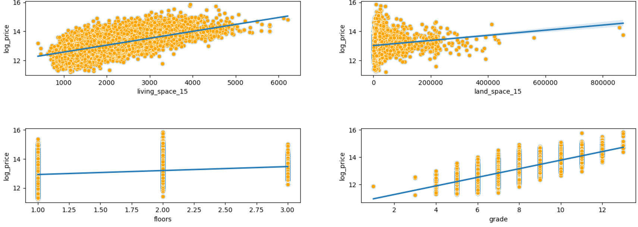
Linearity of independent features
09/12/2024
2

Slide 13
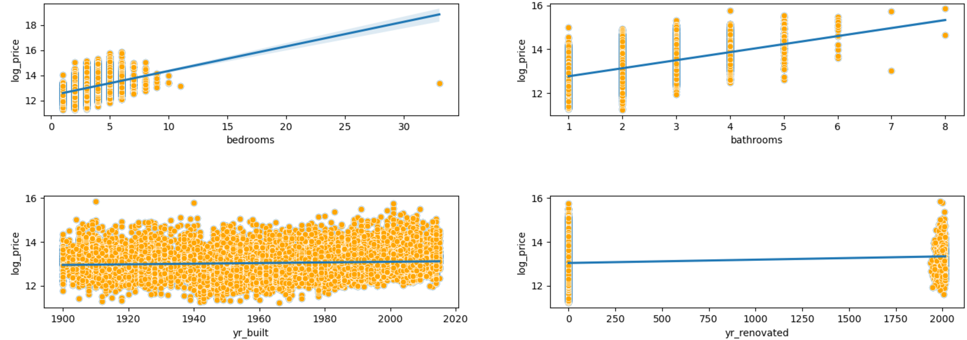
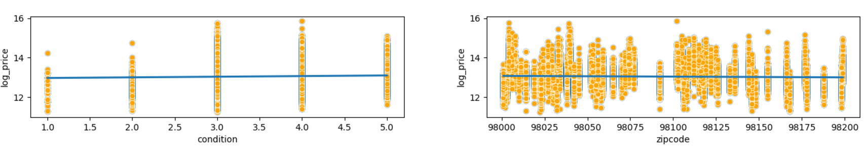
Linearity of independent features
09/12/2024
12

Slide 14
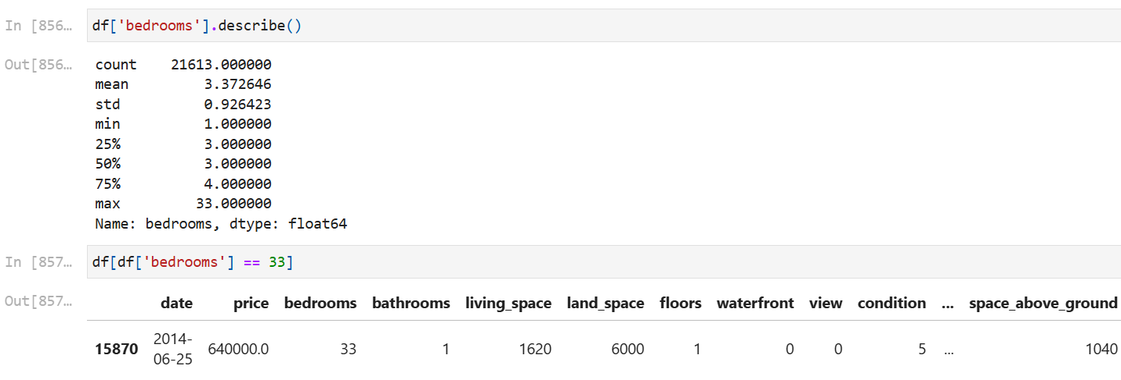
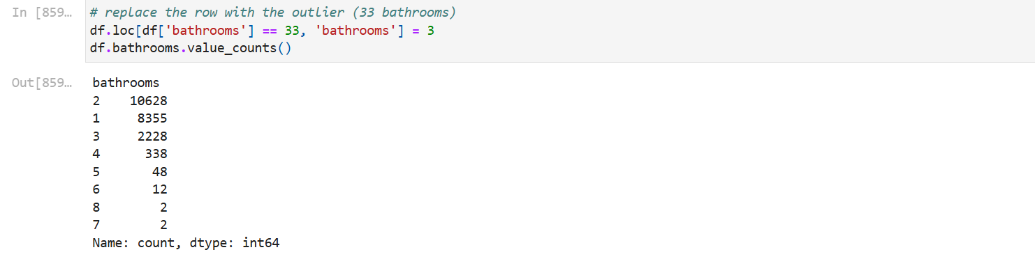
Outliers
09/12/2024
13

Slide 15
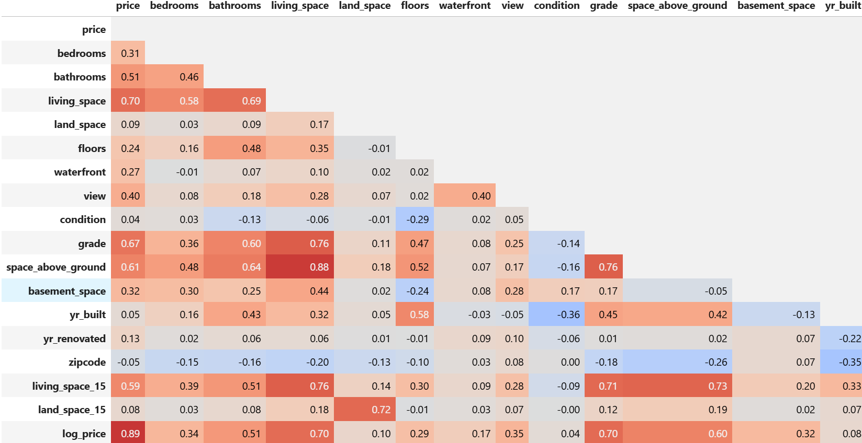
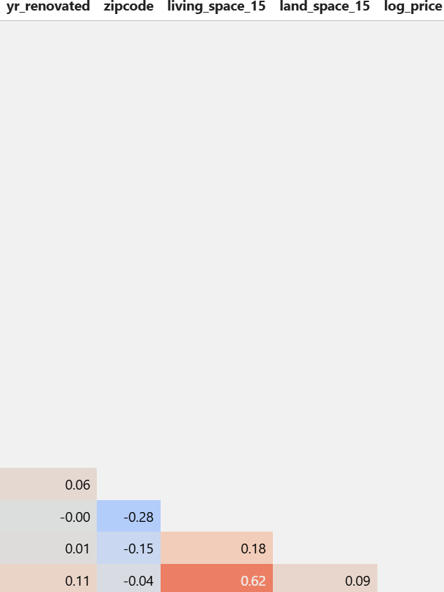
Correlation
09/12/2024
15

Slide 16
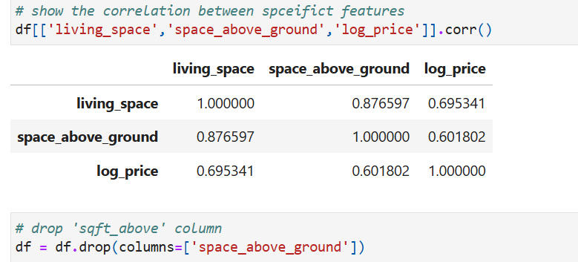
Correlation
09/12/2024
15
Notes:
15

Slide 17
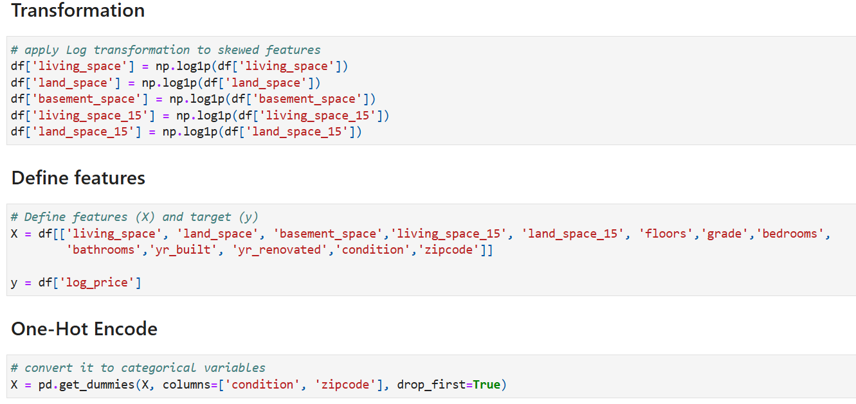
Transformation
12/9/2024
10
Notes:
16

Slide 18
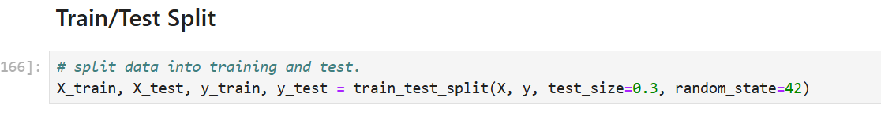
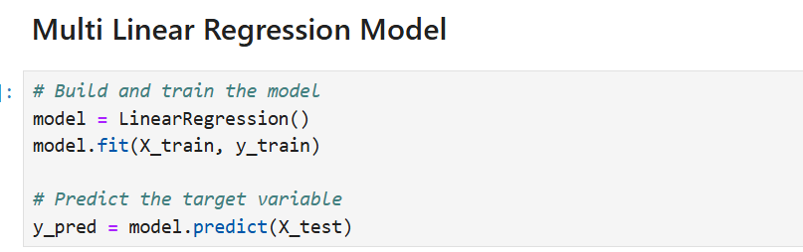
Predictive model
12/9/2024
17
Notes:
17

Slide 19
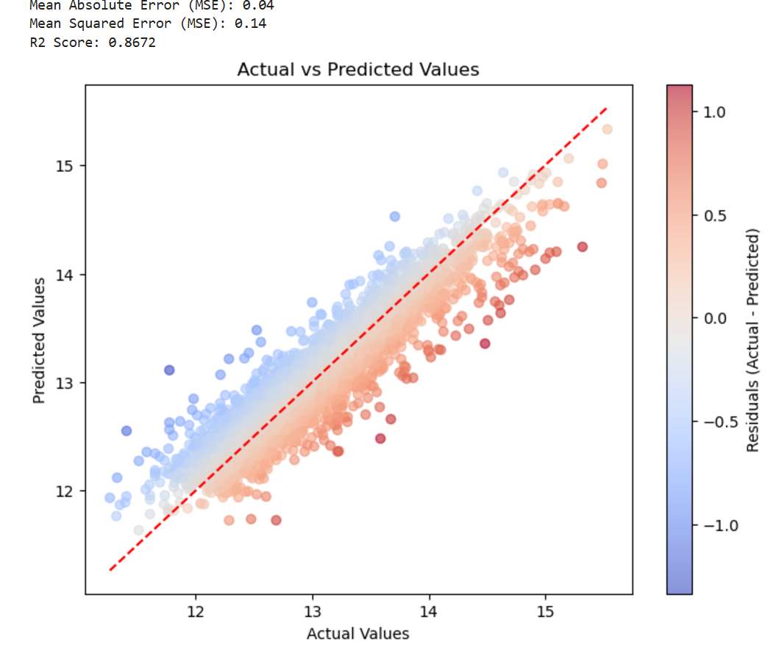
Model Evolution
12/9/2024
2

Slide 20
Conclusion
In conclusion, the model for predicting house prices has demonstrated a high level of accuracy, with an R² value of 86%. This indicates that 86% of the variance in house prices can be explained by the features used in the model, suggesting a strong relationship between the predictors and the target variable. While the model performs well, there is still 14% of the variance that remains unexplained, implying that other factors or data may contribute to the remaining unpredictability. Overall, the model appears to be reliable for forecasting house prices, although more development could improve its performance.
09/12/2024
11

Slide 21
Sources and Tools
Kaggle
Python
Anaconda
Jupyter
Power point
12/9/2024
3

Slide 22
Thank you !
12/9/2024
4

